Slide 1

5G coverage data visualization
Information Visualization
Final Presentation
Qiming Zhao
qiz113@pitt.edu

Slide 2
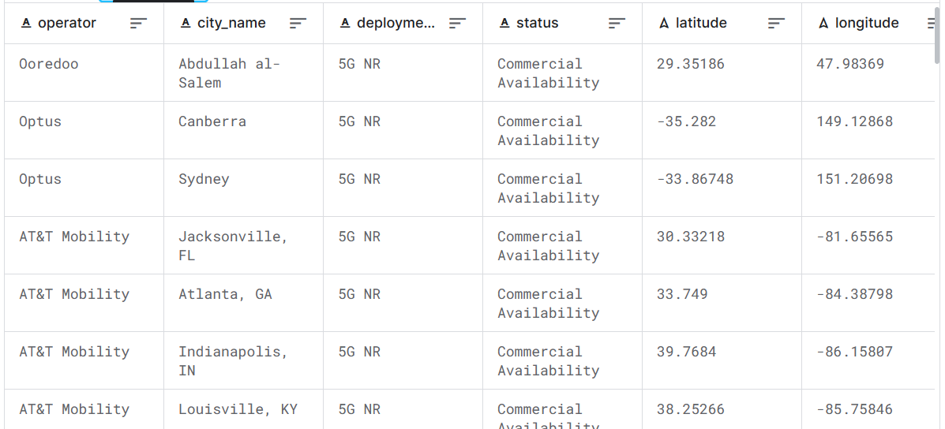
DataSet
Source of the dataset: 5G Coverage Worldwide
https://www.kaggle.com/datasets/ddosad/5g-coverage-worldwide
The dataset contains:
104,033 cities
236 operators
145,629 pieces

Slide 3
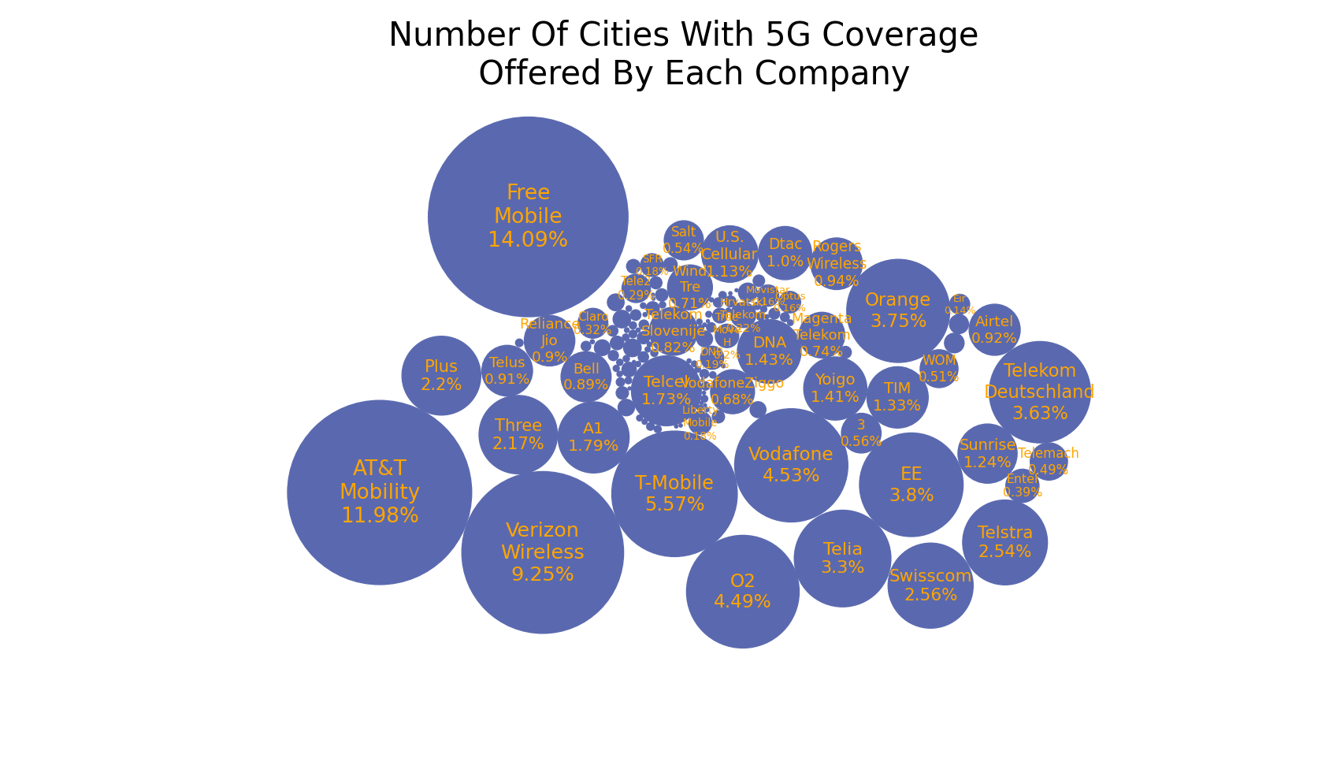
Figure-1: Bubble Chart
Legend:
Circle: 5G Operator Companies
Circle-size: Number of cities offered by the particular company
Text: Company names and its percentage value of the total
Text-size: Logarithm of the number of cities

Slide 4
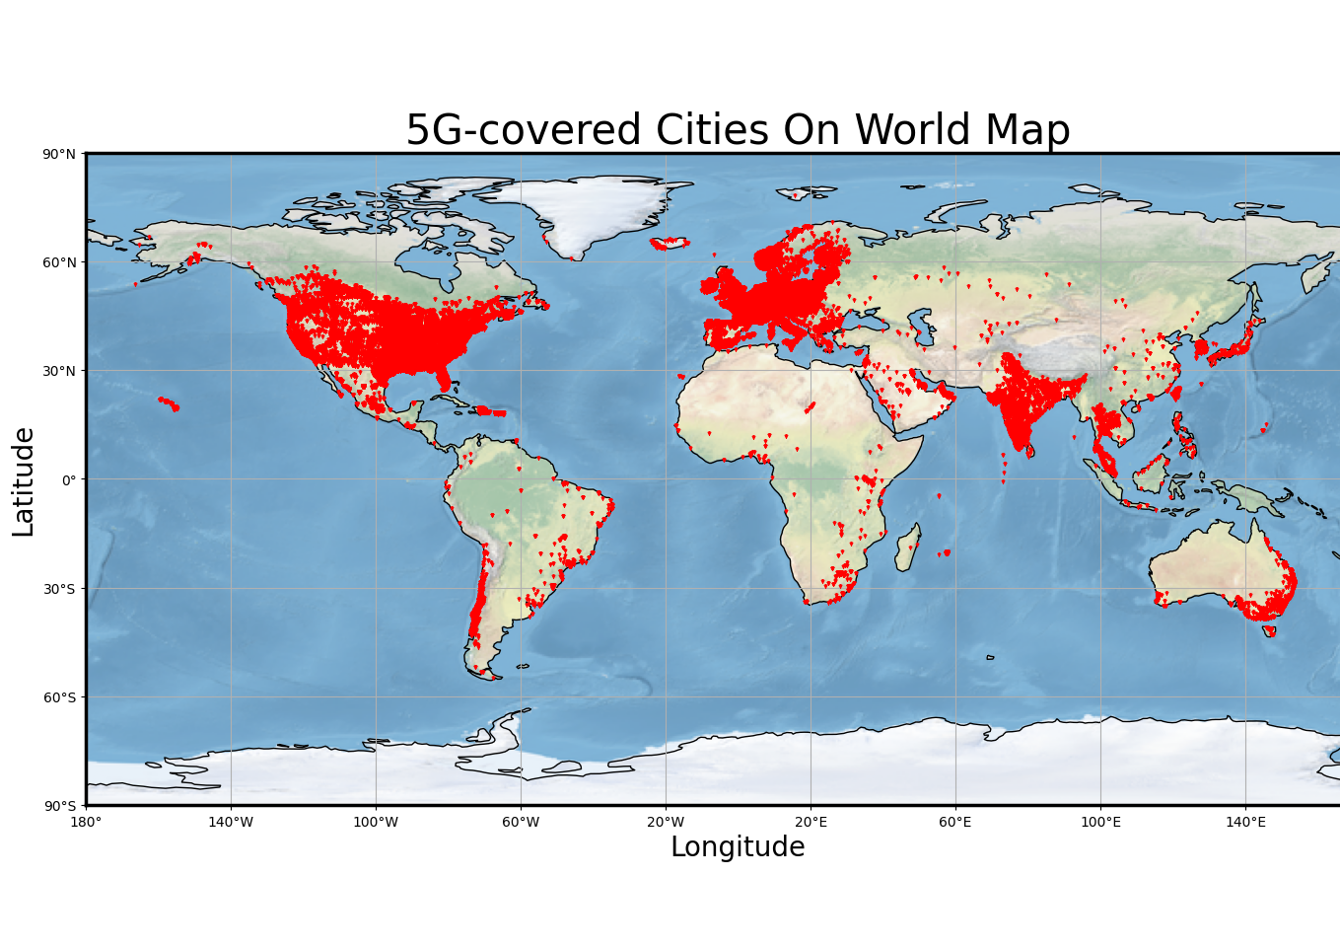
Figure-2: Geographic World Map Chart
Legend:
X-axis: The longitude coordinate from -180 degrees to 180 degrees, with a scale line every 40 degrees.
Y-axis: The latitude coordinate, from -90 degrees to 90 degrees, with a scale line every 30 degrees.
Red triangular dots: representing the latitude and longitude coordinate
Background: The background image is a flat unfolded world map, also Mercator projection mapped.

Slide 5
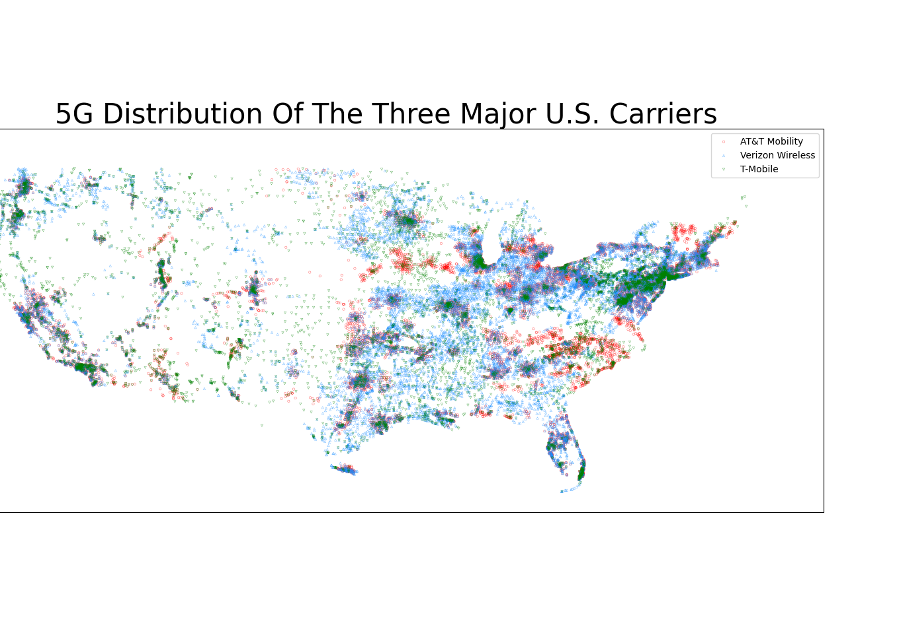
Figure-3: City Coverage Scatter Chart of the Three Major U.S. Carriers
Legend:
X-axis: Longitude coordinate from -128 degrees to -62 degrees
Y-axis: Latitude coordinate, from 23 degrees to 52 degrees
Basically, the longitude and latitude range of the continental United States
Red circle point: "AT&T Mobility"
Blue upward triangle: "Verizon Wireless"
Green downward triangle: "T-Mobile"

Slide 6
Method used in this process:
Matplotlib
Scatter()
Plot()
Cartopy
Algorithm: bubble collision calculate
Why the presented figure is important:
Bubble chart: To determine a company's business value and capabilities
Geographic chart: 5G coverage between different countries; Shows which cities are emerging cities
Scatter chart: Differences in deployment strategies; To analyze business strategies and city relationships;

Slide 7
Thank you!

